Slide 1
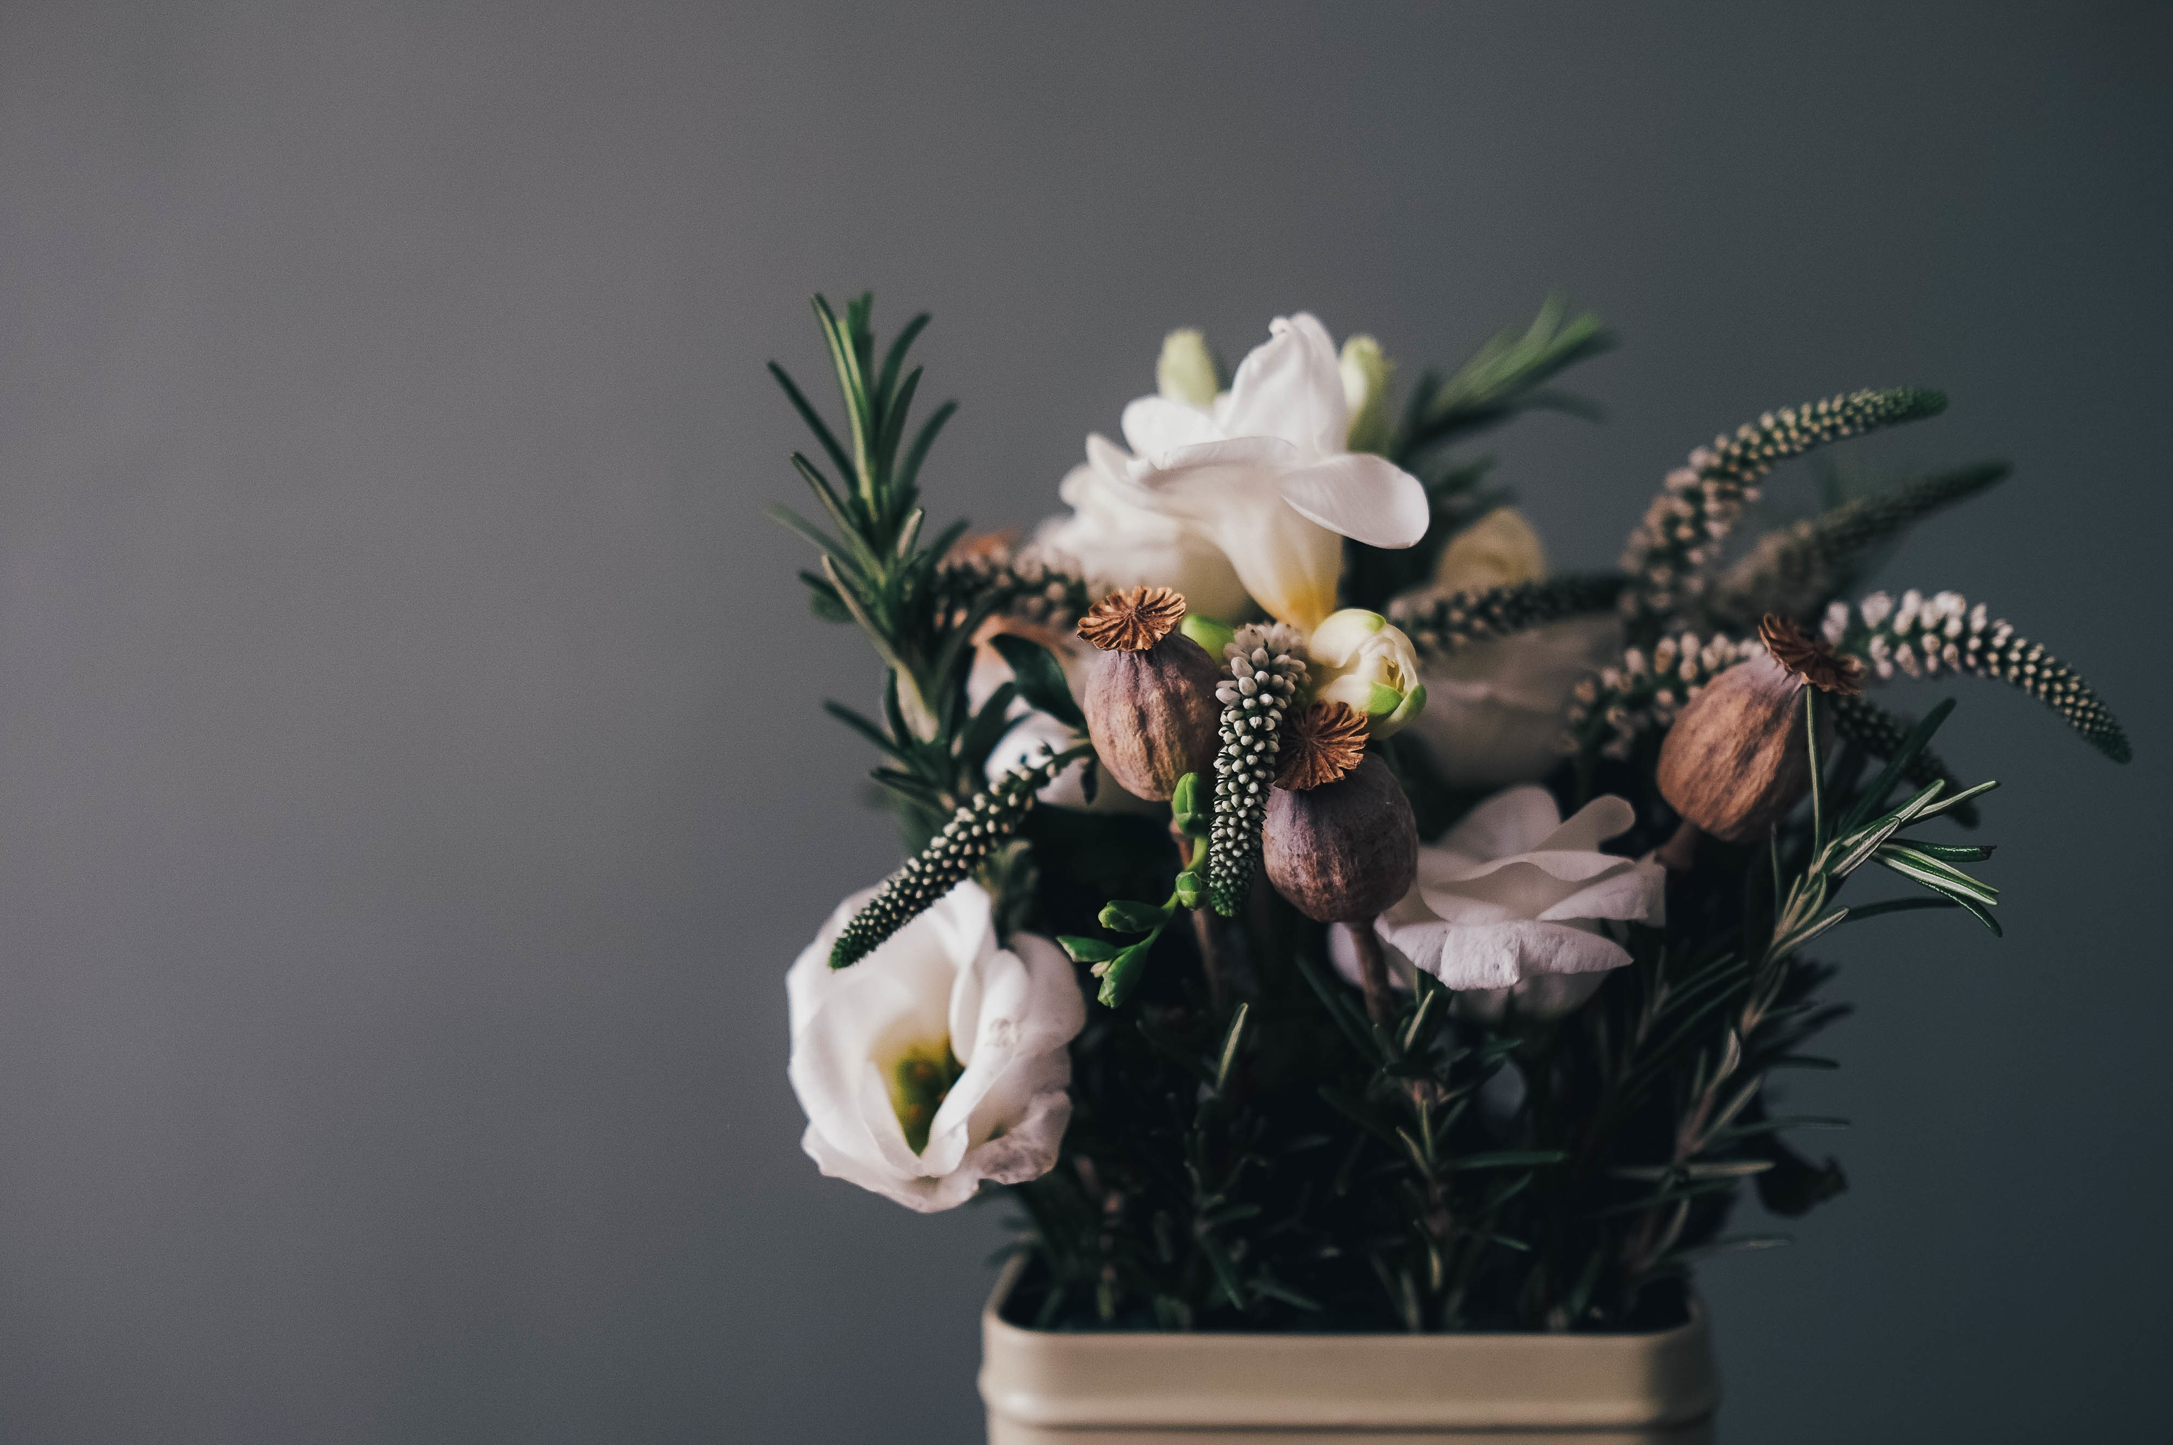


Blending tradition with modern tech
Verde Rosa website
Dr:Bilal Nakhal
Dr:Mostafa Chehaitly
Presenters: Layth and Amjad

Slide 2
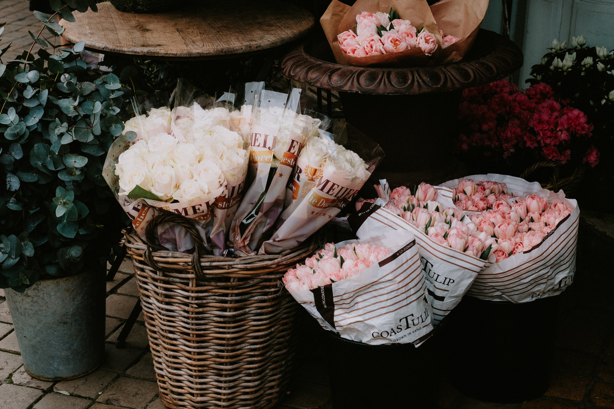

About Verde-Rosa
20+ years old flower shop in Hamra, Beirut
Owned by an elderly florist
known for authentic, handcrafted bouquets

Slide 3
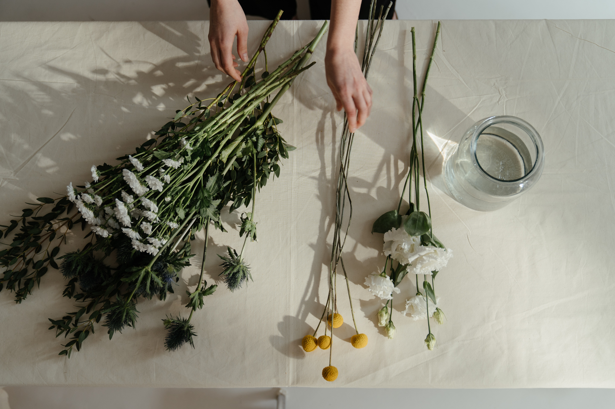
Verde Rosa flower shop
Project Motivation
Preserve tradition while modernizing, expand reach beyond physical store while creating a digital tribute to the shop’s legacy.

Slide 4
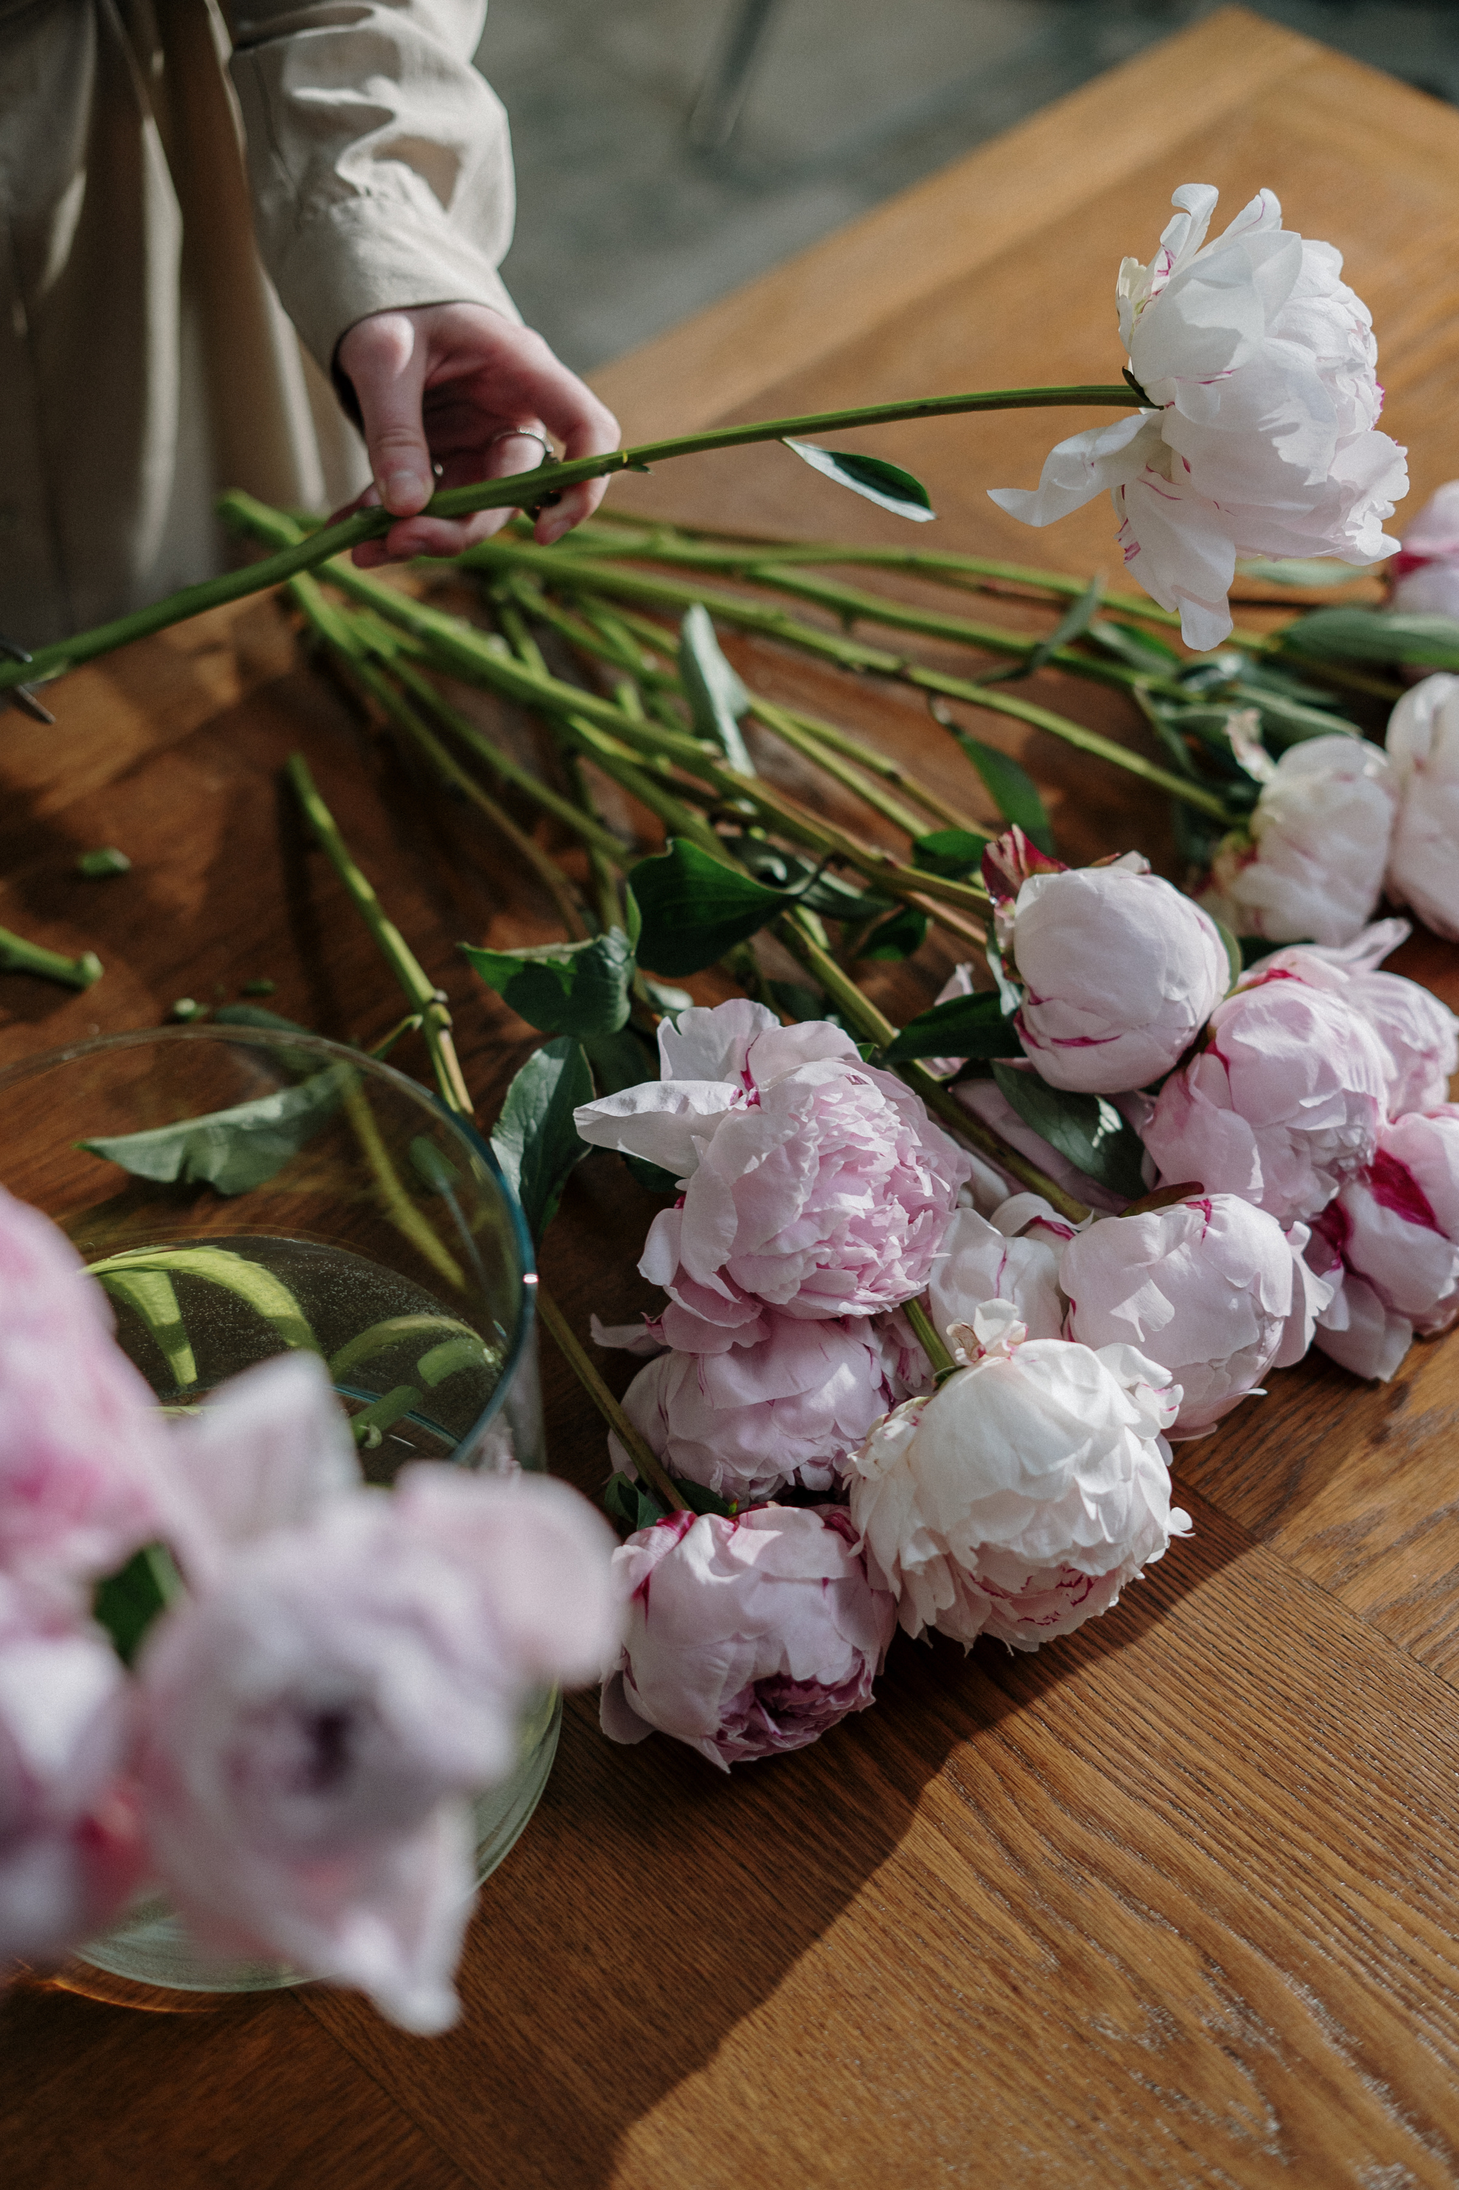
Verde Rosa Flower Shop
Objectives
We aim to build a responsive, user-friendly website that showcases our products in a visually appealing way while offering a smooth and enjoyable browsing experience. The platform will support full online shopping features, including a shopping cart and a secure login system, making it easy for customers to explore and purchase items. Additionally, the website will promote sustainability by integrating a donation element that encourages users to contribute to eco-friendly initiatives.

Slide 5
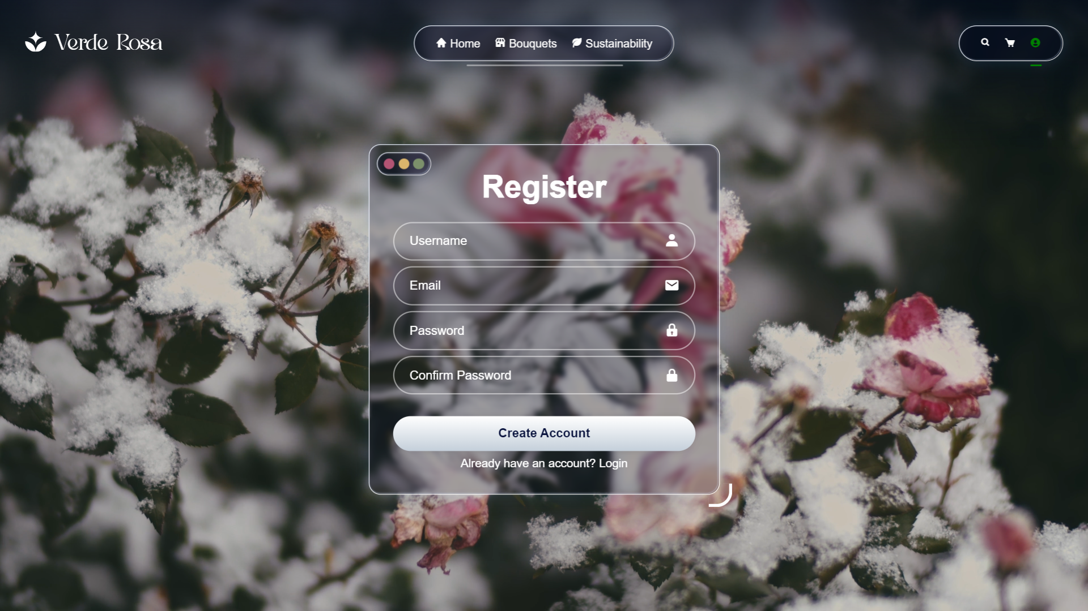
Website Navigation
Verde Rosa Flower Shop
The website features a navigation bar built with React Router, allowing smooth and seamless transitions between different sections of the platform. It includes dedicated pages for Home, Products, Cart, Login, and Sustainability, ensuring a clear structure and easy access to all key areas of the site..

Slide 6
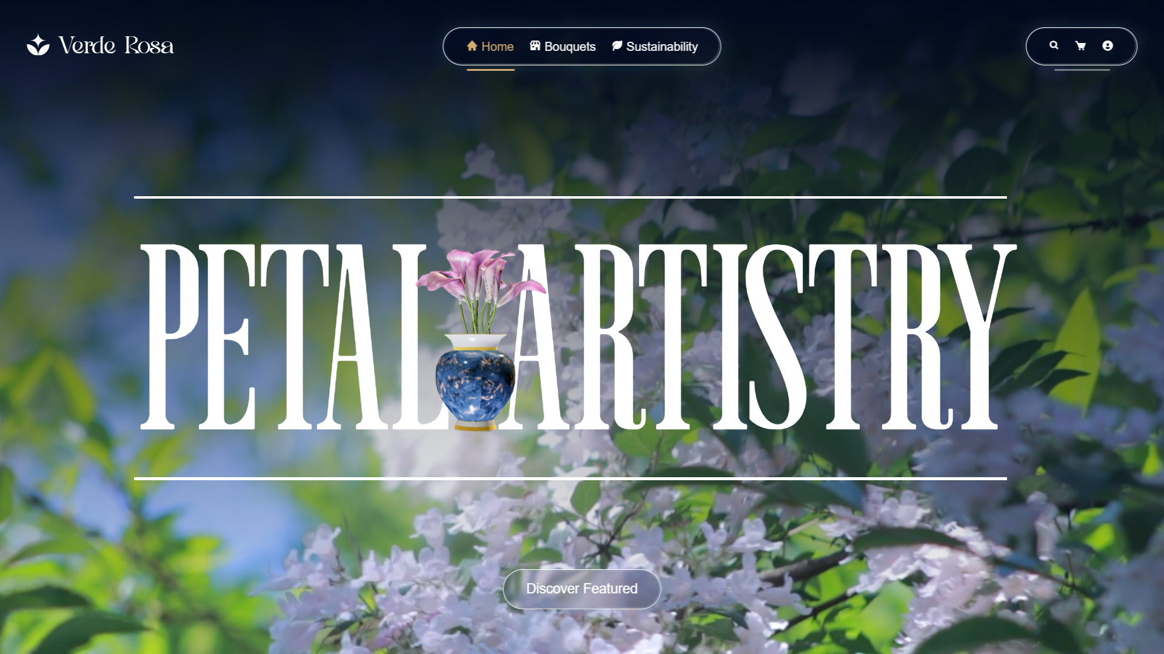
Home Page
The site opens with a clean, floral design that feels fresh and inviting, complemented by a striking 3D SVG model that gently twists as the user scrolls to add depth and motion. A warm, welcoming introduction to Verde-Rosa greets visitors, immediately communicating the brand’s personality and setting the tone for an engaging user experience.

Slide 7
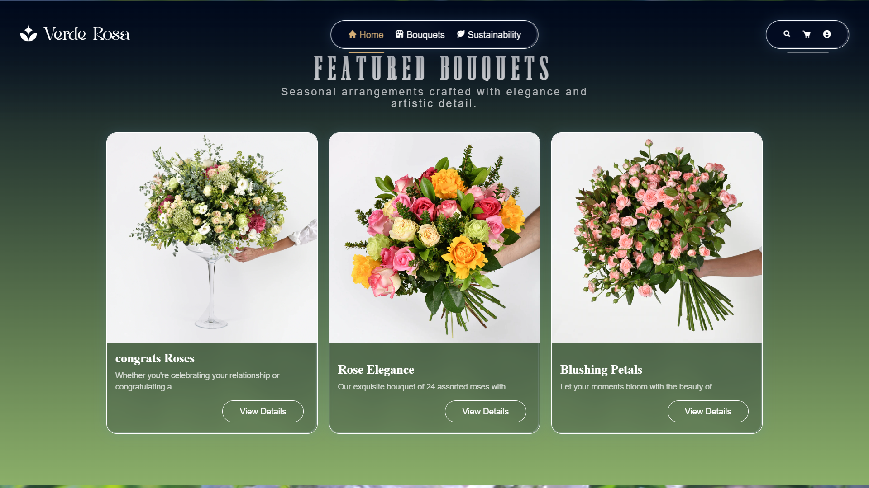
Home Page
The site opens with a clean, floral design that feels fresh and inviting, complemented by a striking 3D SVG model that gently twists as the user scrolls to add depth and motion. A warm, welcoming introduction to Verde-Rosa greets visitors, immediately communicating the brand’s personality and setting the tone for an engaging user experience.

Slide 8
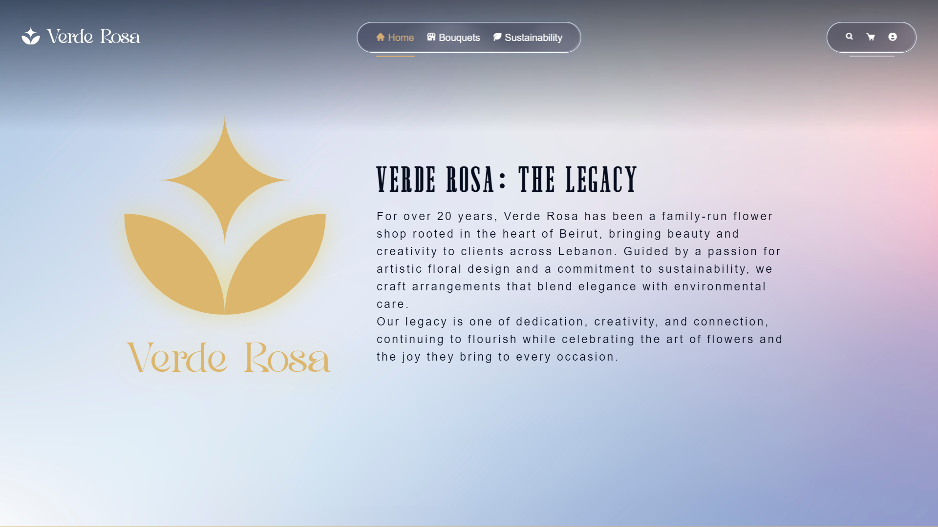
Home Page
The site opens with a clean, floral design that feels fresh and inviting, complemented by a striking 3D SVG model that gently twists as the user scrolls to add depth and motion. A warm, welcoming introduction to Verde-Rosa greets visitors, immediately communicating the brand’s personality and setting the tone for an engaging user experience.

Slide 9
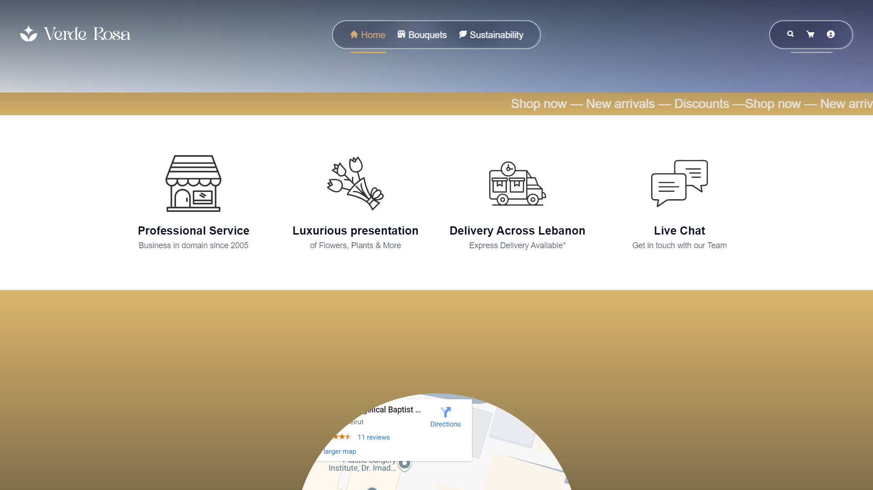
Home Page
The site opens with a clean, floral design that feels fresh and inviting, complemented by a striking 3D SVG model that gently twists as the user scrolls to add depth and motion. A warm, welcoming introduction to Verde-Rosa greets visitors, immediately communicating the brand’s personality and setting the tone for an engaging user experience.

Slide 10
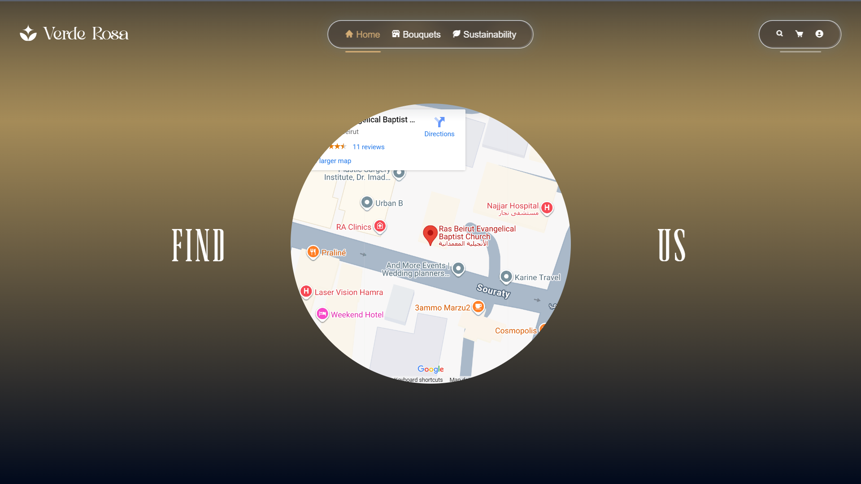
Home Page
The site opens with a clean, floral design that feels fresh and inviting, complemented by a striking 3D SVG model that gently twists as the user scrolls to add depth and motion. A warm, welcoming introduction to Verde-Rosa greets visitors, immediately communicating the brand’s personality and setting the tone for an engaging user experience.

Slide 11
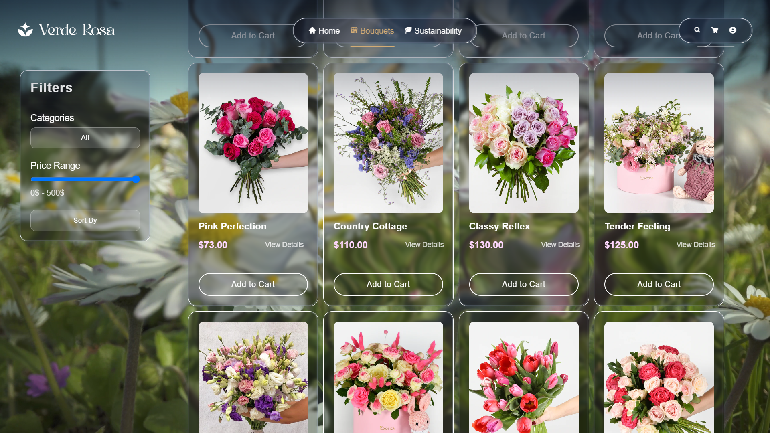
Verde rosa Flower Shop
Products Page
The website includes a detailed catalog of flowers and bouquets, presenting each item with clear images, descriptions, and prices to help customers make informed choices. Every product features convenient add-to-cart functionality, making the shopping experience smooth and intuitive from browsing to checkout.

Slide 12
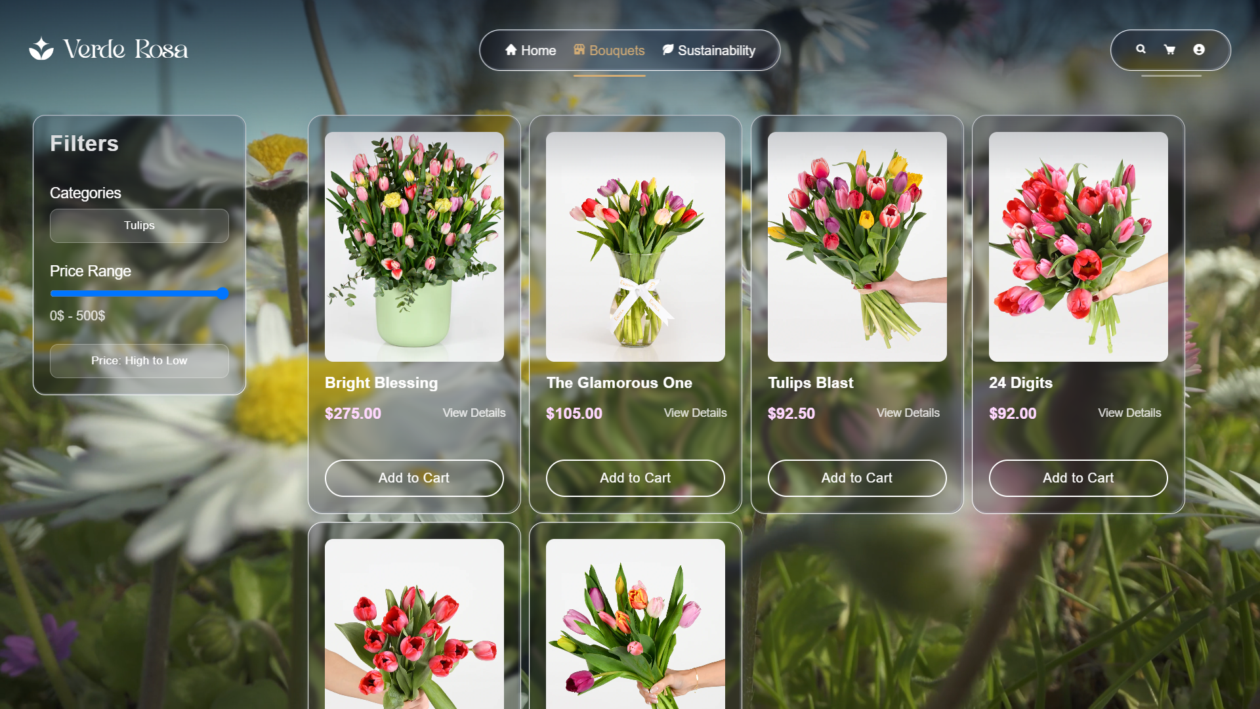
Verde rosa Flower Shop
Products Page
The website includes a detailed catalog of flowers and bouquets, presenting each item with clear images, descriptions, and prices to help customers make informed choices. Every product features convenient add-to-cart functionality, making the shopping experience smooth and intuitive from browsing to checkout.

Slide 13
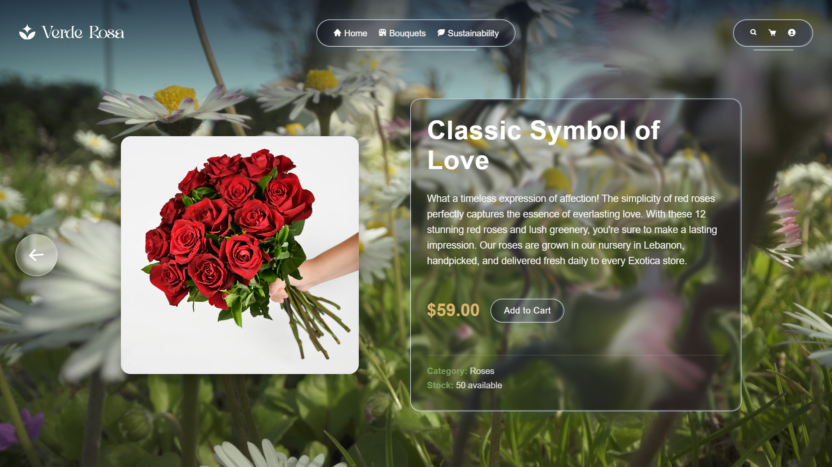
Verde rosa Flower Shop
Products Page
The website includes a detailed catalog of flowers and bouquets, presenting each item with clear images, descriptions, and prices to help customers make informed choices. Every product features convenient add-to-cart functionality, making the shopping experience smooth and intuitive from browsing to checkout.

Slide 14
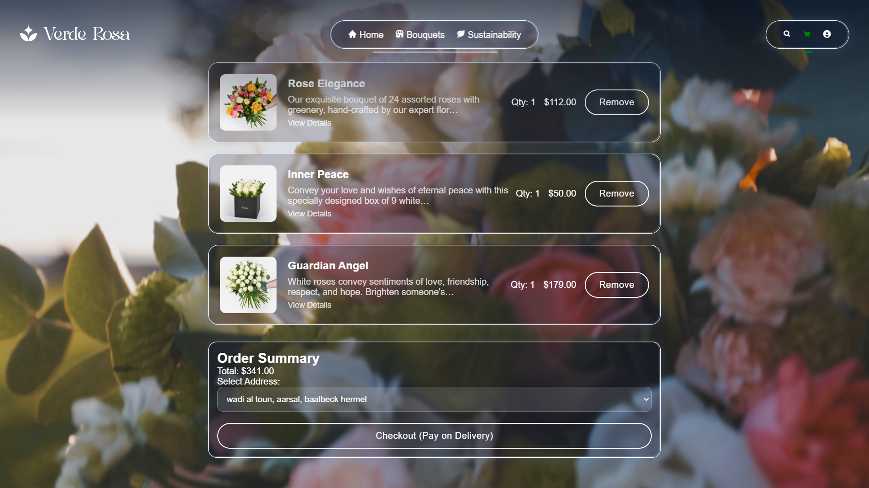
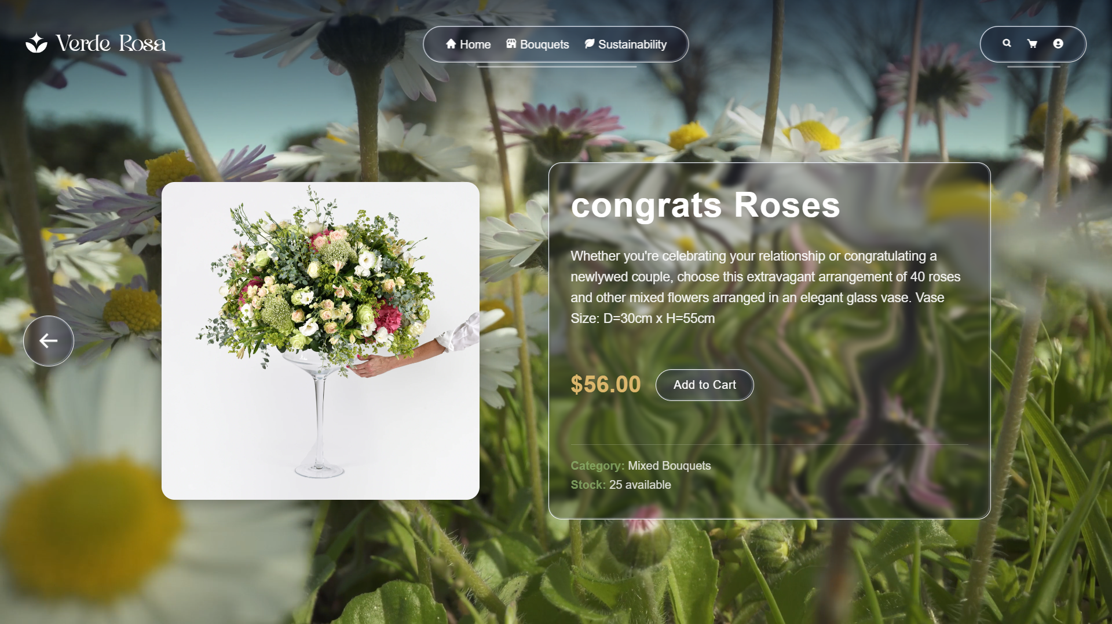
Verde Rosa Flower Shop
The platform features a complete cart and checkout system designed for convenience and clarity. Users can easily manage their items through the shopping cart interface and proceed through a smooth, intuitive checkout flow. While the payment integration is conceptual, the system emphasizes security and reliability, ensuring a trustworthy foundation for handling future transactions.
Cart & Checkout

Slide 15
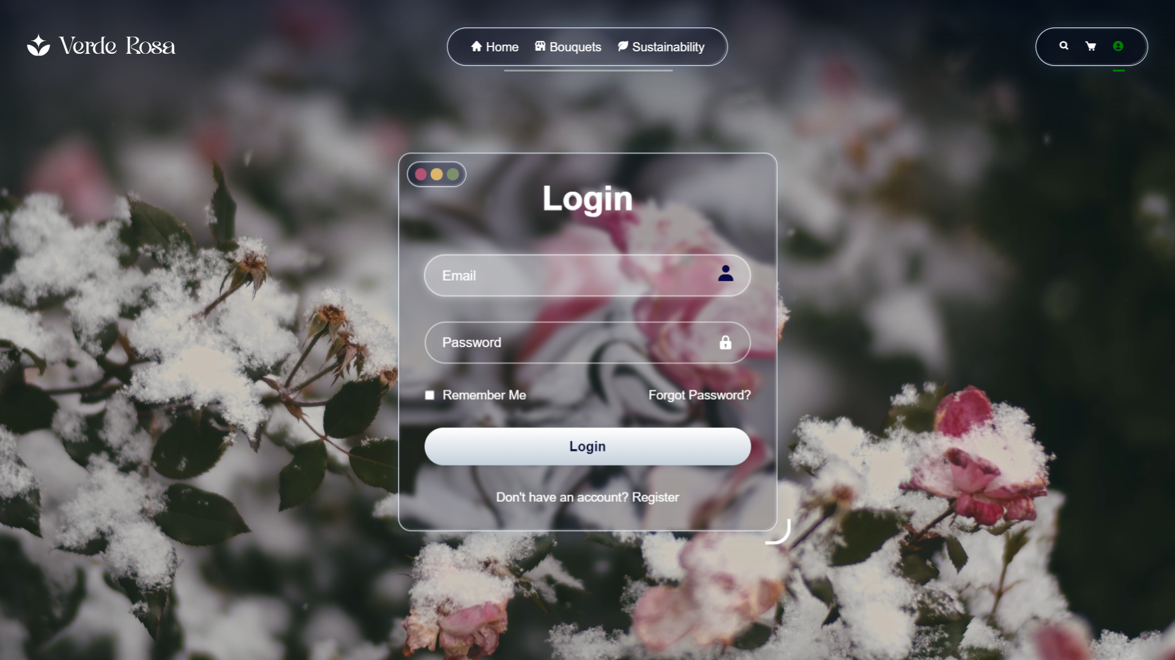
The website provides secure login for returning users, allowing access through an email or username and password. This personalized system offers features like saved carts and order histories, while strong data protection ensures user privacy and security.
Login & User Accounts

Slide 16
Register
The website offers a simple sign-up process for new users, collecting basic information such as name, email, and password. This creates a personal account linked to their orders, laying the foundation for future features like a loyalty program and delivery tracking.

Slide 17
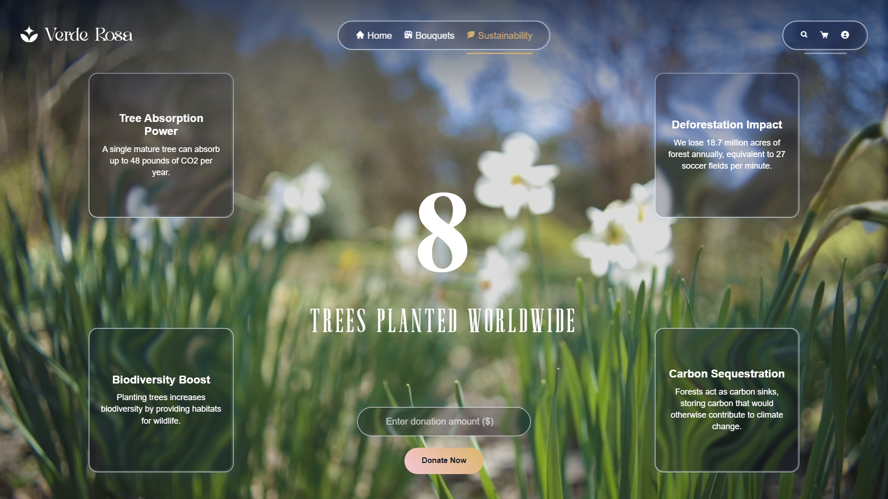
Verde Rose Flower Shop
The website features a dedicated Sustainability page where users can contribute to planting trees, supporting global reforestation efforts. It includes a live counter showing the total number of trees planted worldwide, highlighting the community’s impact. Through API integration, the page provides information on green areas and carbon footprints, connecting the beauty of flowers with environmental responsibility and raising awareness about sustainable practices.
Sustainability Page

Slide 18

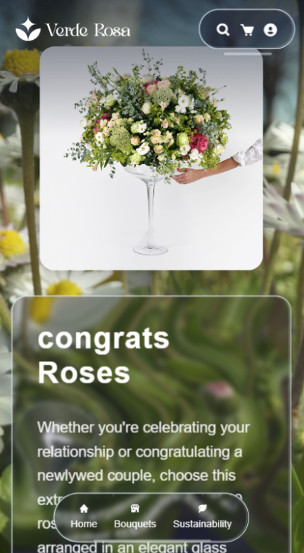
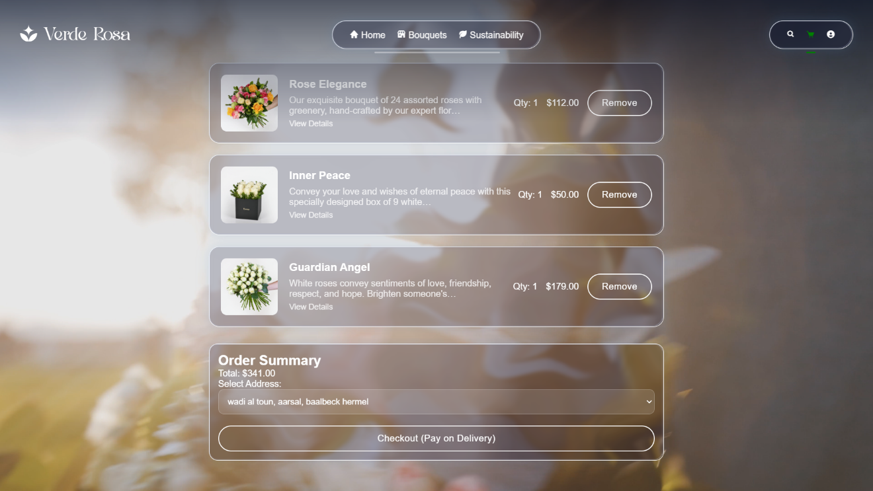
Theme & Colors
Elegant, soft tones to reflect floral identity with the video background.
Layout
The website features a responsive design that adapts seamlessly to both desktop and mobile devices, paired with simple and intuitive navigation to provide a smooth and user-friendly browsing experience.
Visual Effects
The website incorporates a glass-blurred SVG filter on various elements, creating a frosted-glass effect that adds depth and a modern aesthetic. This design choice also enhances contrast between the background and content, making the interface visually appealing and easier to read.
Typography
The website uses clean, modern fonts to ensure readability, while carefully balanced decorative accents reinforce the brand’s identity and add visual interest.
Design Concept

Slide 19
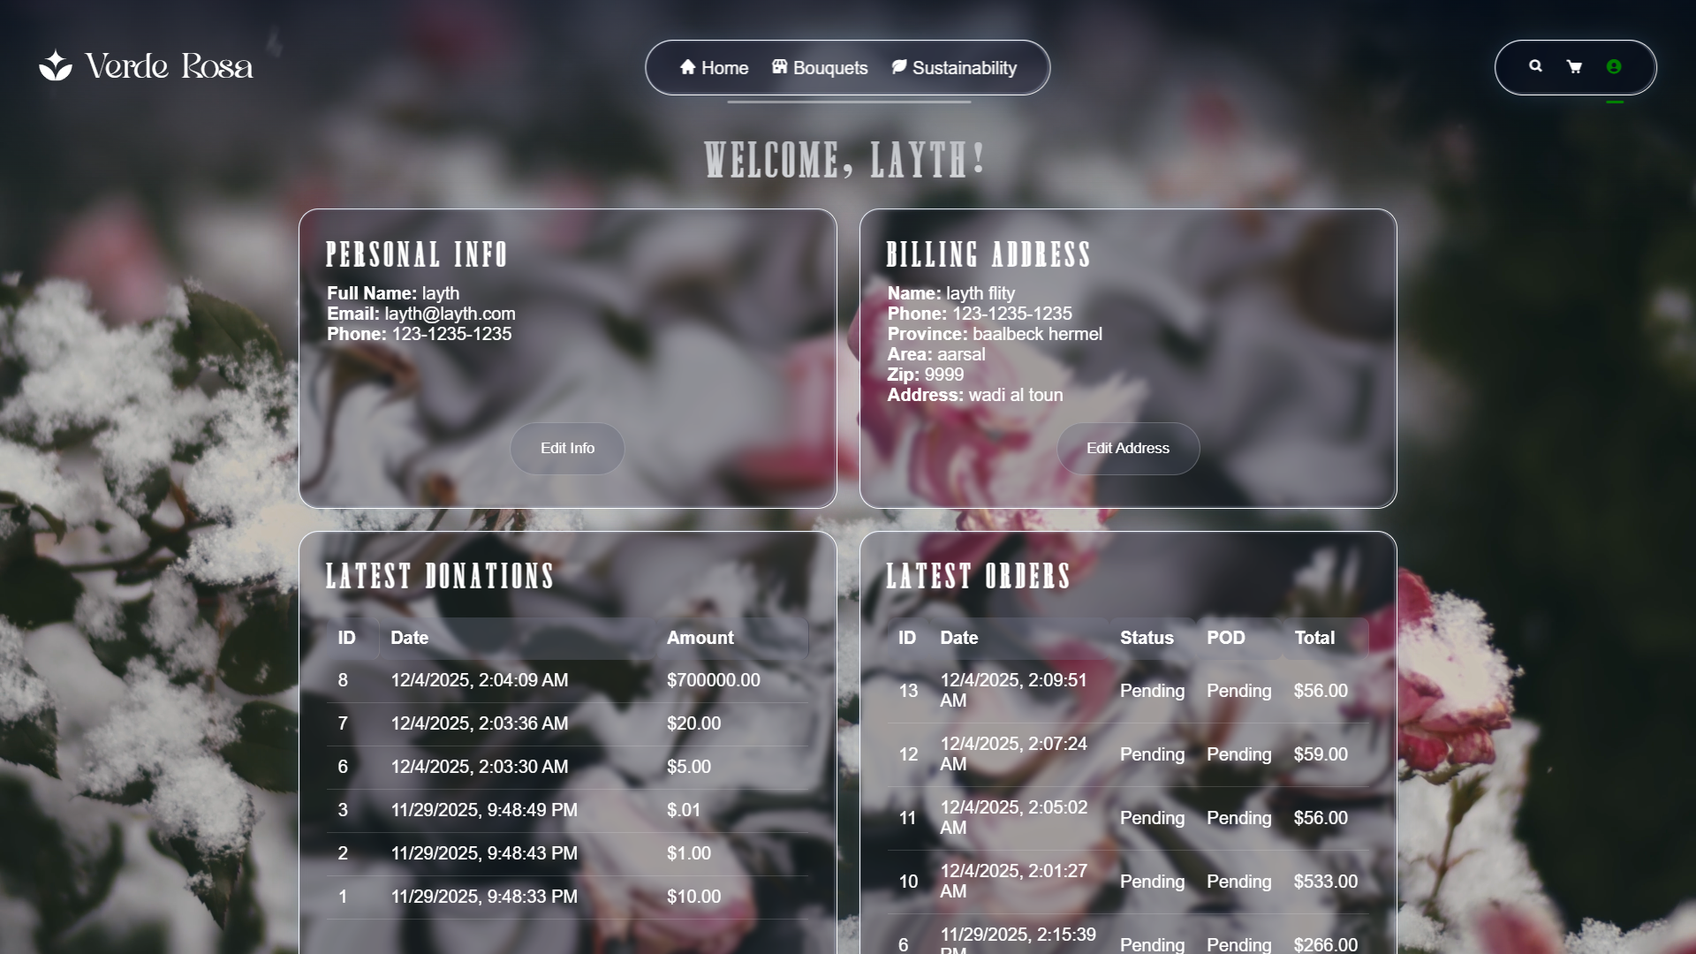
-Frontend:
.
React, React Router, SVG animations
- Backend:
.
PHP, SQL Server
- Database:
Products, Orders, Users, Donations

Slide 20
Tech Stack
Verde Rosa Flower Shop
Layer | Technology | Purpose
Frontend | React.js (Vite) | Fast, interactive UI and routing
Styling | CSS + Glassmorphism | Modern, glass-effect aesthetic
Backend | PHP | API endpoints, session management, data handling
Database | SQL Server (SSMS) | Stores products, users, orders, donations
Server | PHP built-in server | Local backend development
Additional Tools | Illustrator | Logo and UI graphics

Slide 21
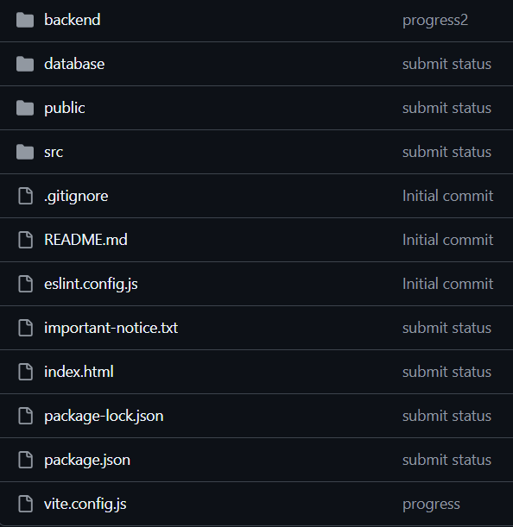
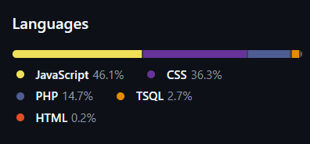
New experience: Working on github
The project uses Git for version control, enabling effective collaboration and streamlined code management. It allows tracking of issues and commits, ensuring that changes are organized and documented, while hosting the repository promotes transparency and easy access for team members.

Slide 22
Verde Rose Flower Shop
Challenges & Learnings
- Balancing tradition with modern design
- Implementing 3D scroll animation
-Integrating sustainability features with API data
-Managing project workflow on GitHub

Slide 23
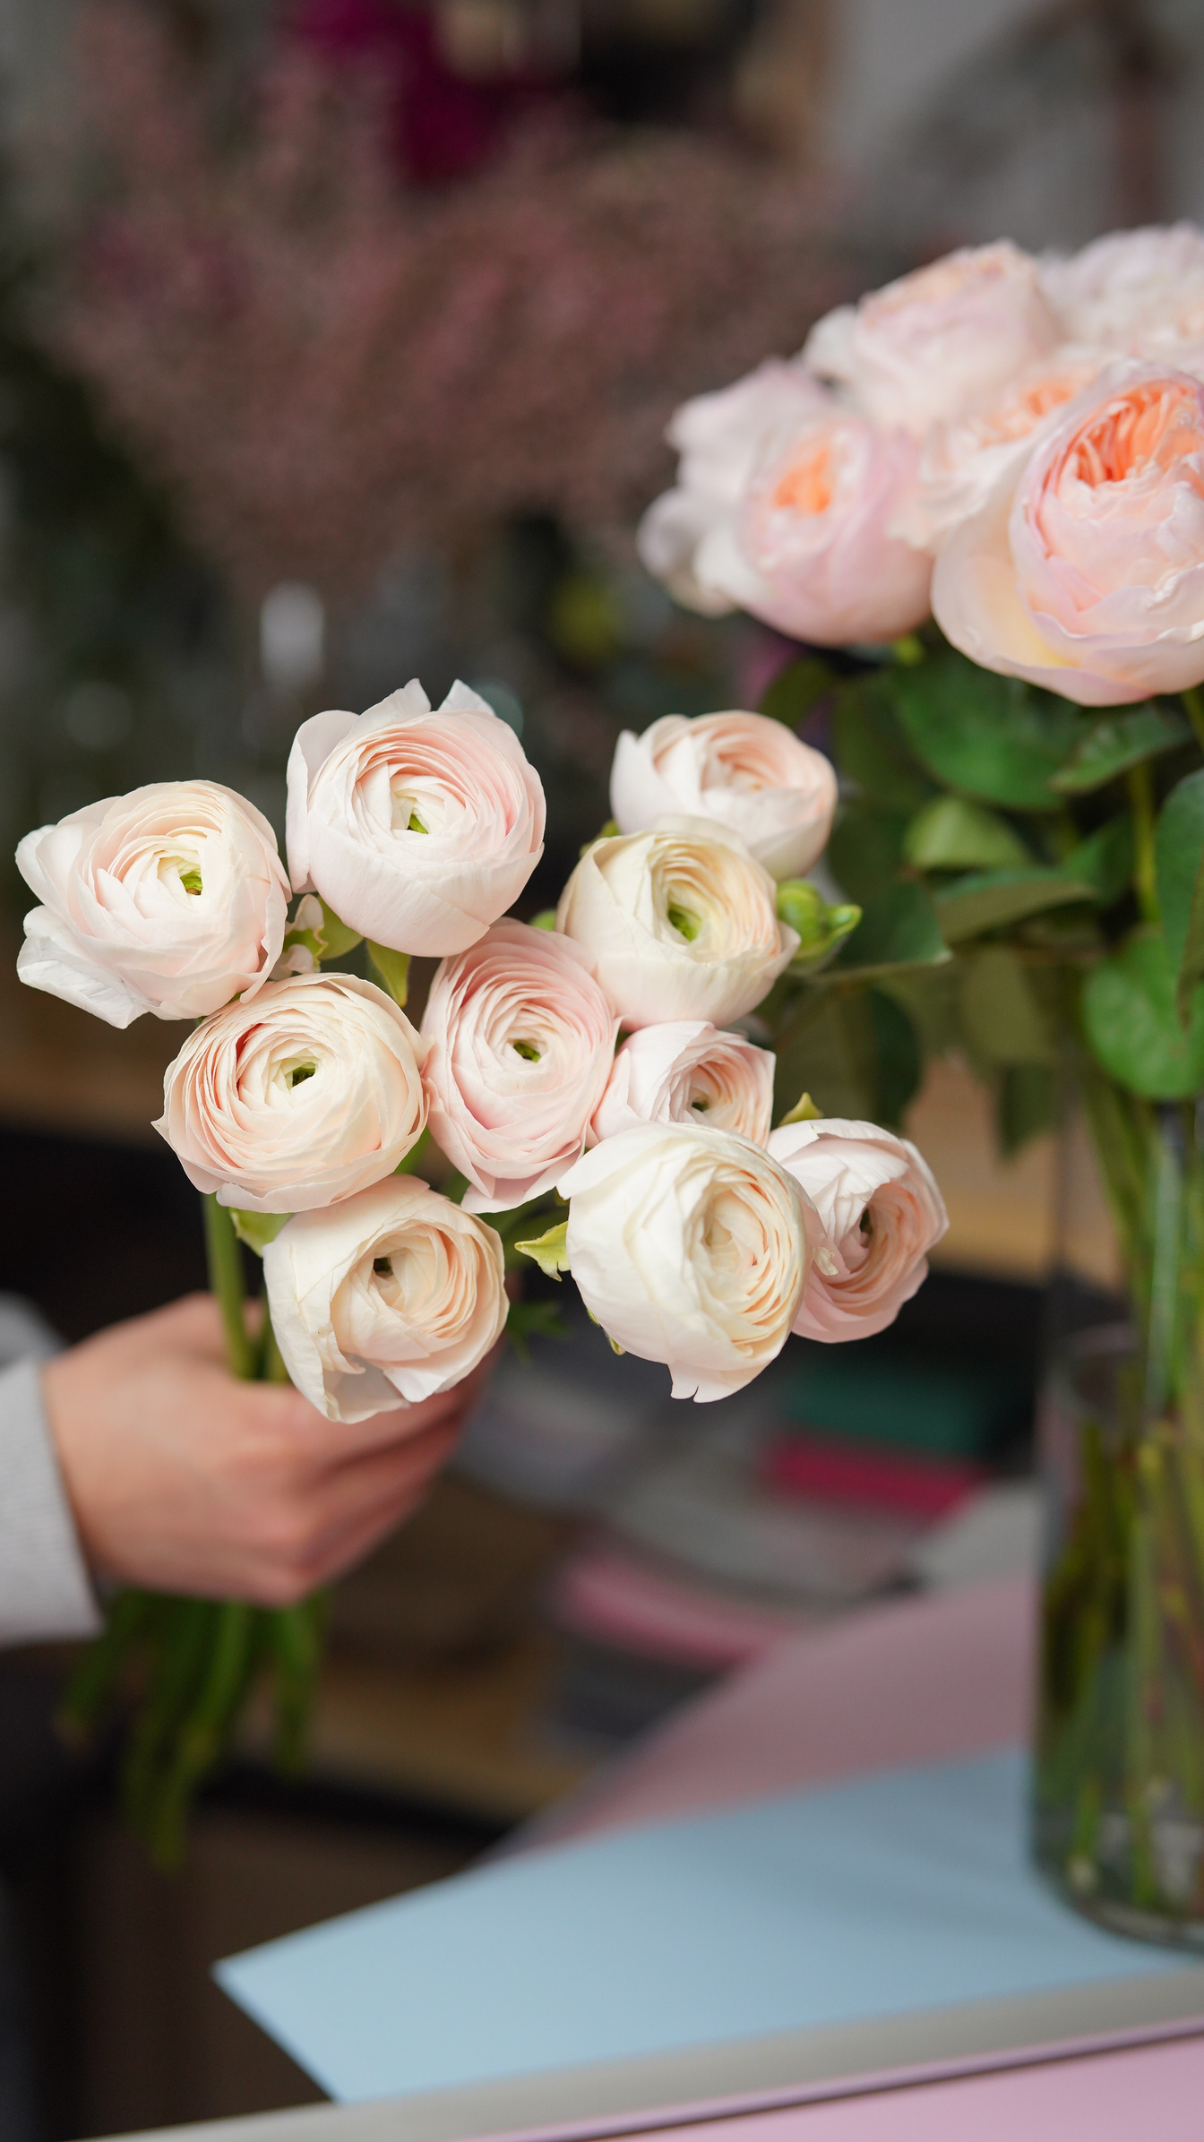
Verde Rosa : a bridge between heritage & innovation
Thank You For Your Attention
Website as a tribute to the florist’s legacy

